Slide 1
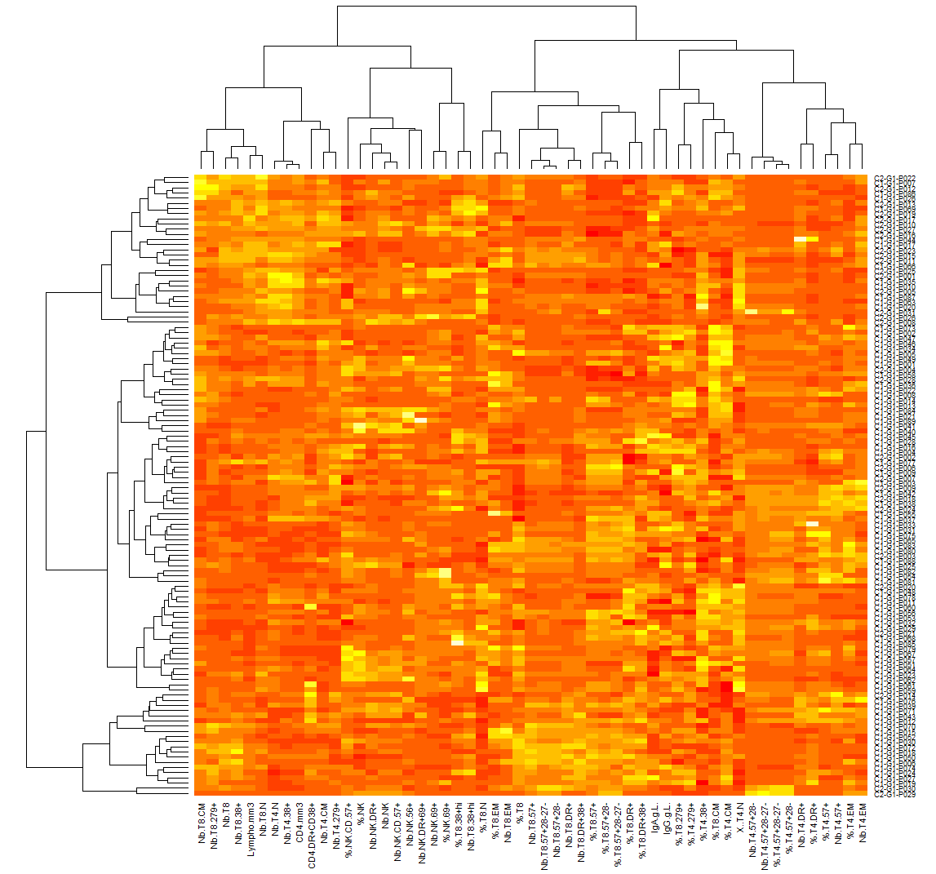
Observations (patients)
T4
Variables (markers)
N, naïve; EM, effector memory; CM, central memory

